Slide 1
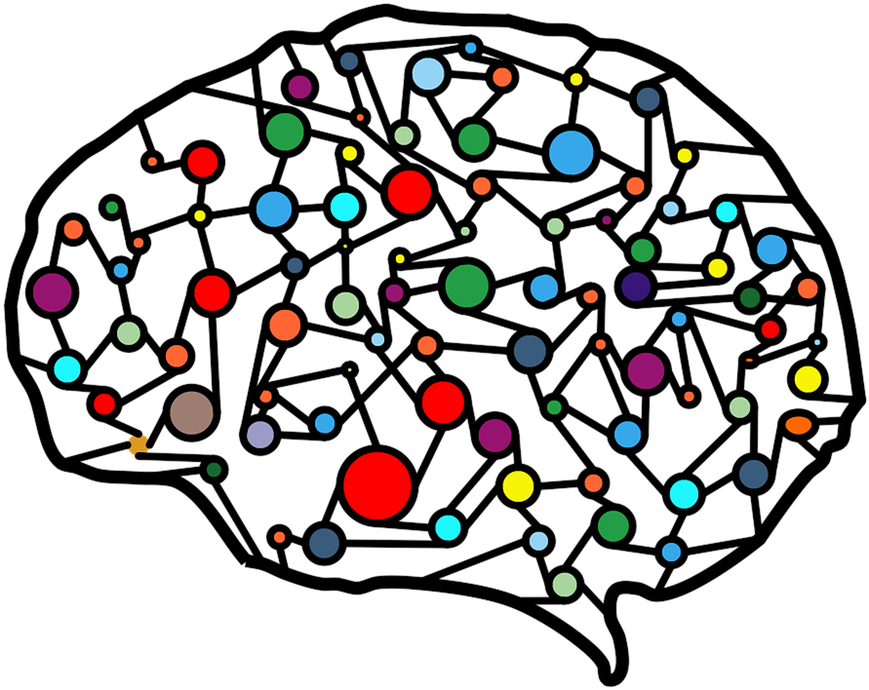
Introduction to Image Classification using Convolutional Neural Networks (CNNs)
Module 6 – Vision modelS

Slide 2

Content
Overview
Convolutional Neural Networks
Convolutions
Filters
Pooling layers
Use Cases:
Image Classification
Object Detection

Slide 3
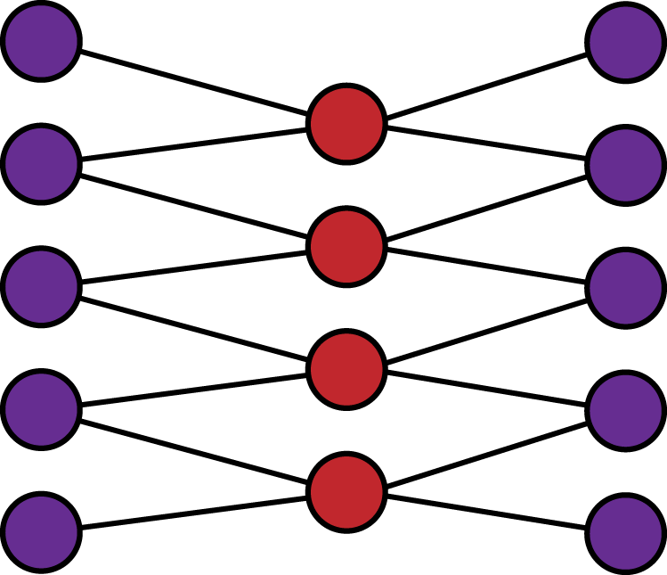
Convolutional Neural Network
CNNs

Slide 4
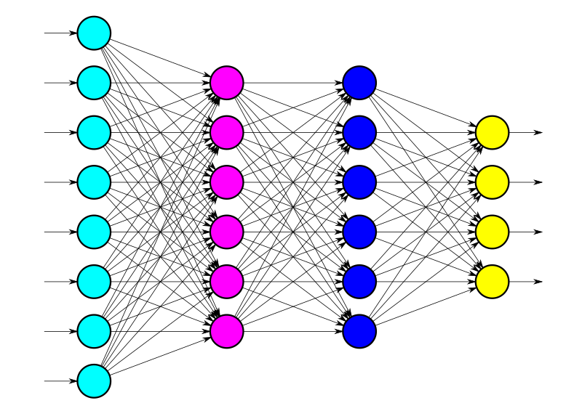
What is a Convolutional Neural Network?
What is a CNN? - A type of deep learning model designed for image processing. - Mimics visual perception in humans. - Consists of multiple layers to extract features from images

Slide 5
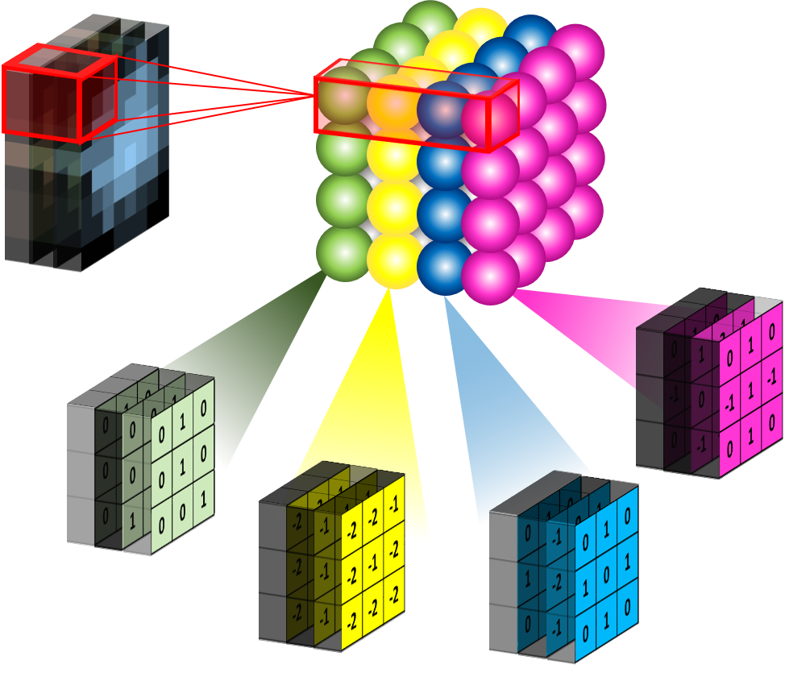
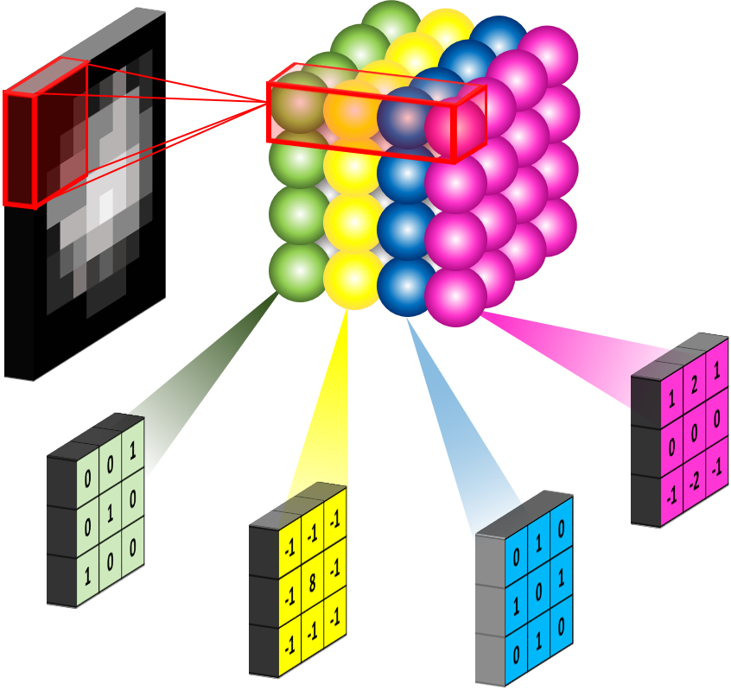
Convolutions
1D and 3D

Slide 6
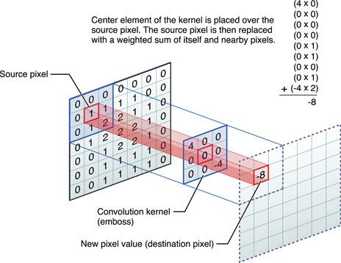
What are Convolutions?
- Definition: A mathematical operation that combines two functions. - Purpose: To extract features like edges from images. - Process: Apply a filter (kernel) over the image, computing dot products.

Slide 7
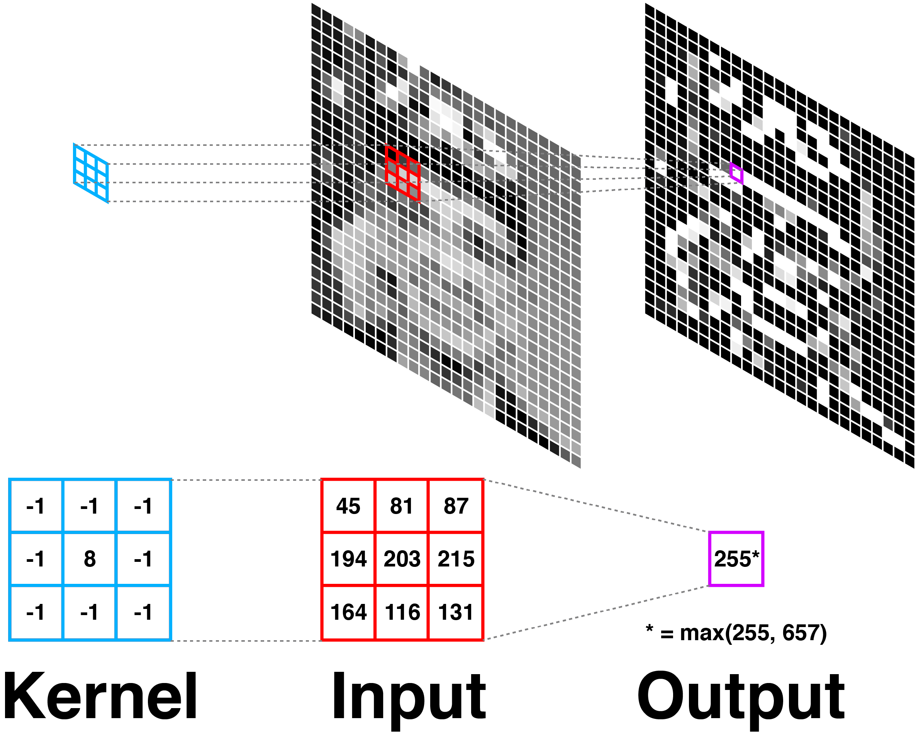
Filters

Slide 8
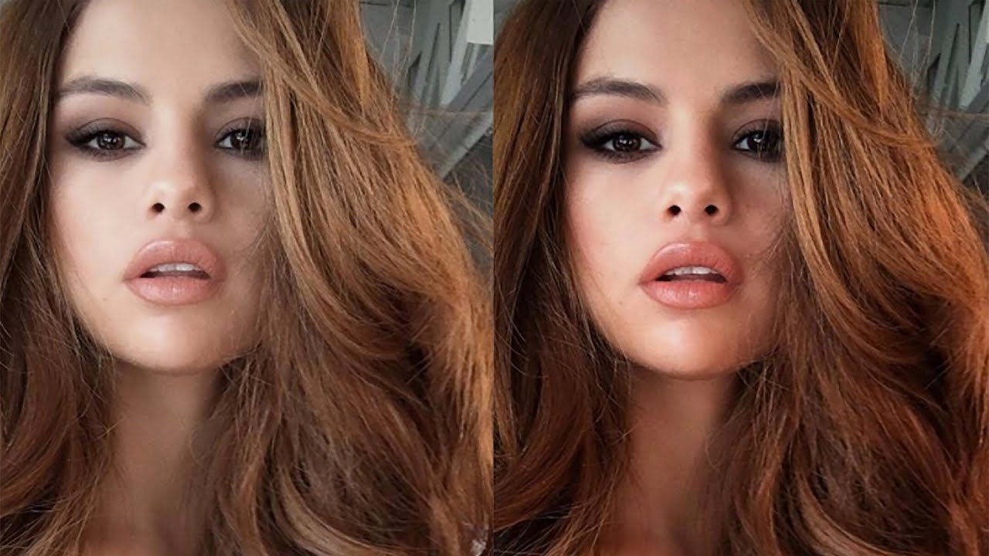
What are Filters?
Small matrices used in convolutions. - Detect specific features (e.g., edges, textures). - Different filters highlight different aspects of the image.
Ex. Instagram, Adobe Photoshop filters
Source:Youtube Selena Gomez shares her filters

Slide 9
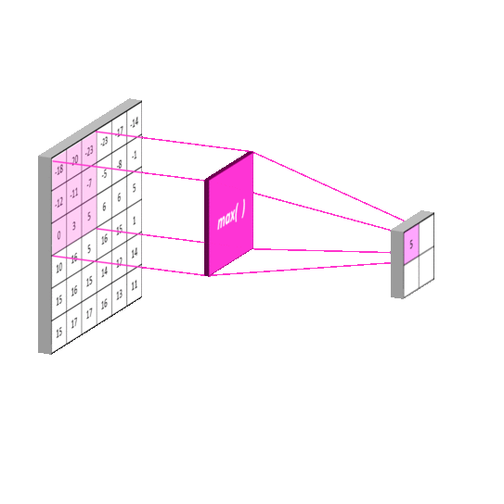
Pooling Layers

Slide 10
What are Pooling Layers?
Function: Reduces spatial dimensions of the feature maps.
Why? Images can be voluminous (resolutions, size)
Solution: Focus on the essential features - Types: - Max Pooling: Takes the maximum value from a set of values. - Average Pooling: Takes the average value. - Benefits: Decreases computational load and helps prevent overfitting.

Slide 11
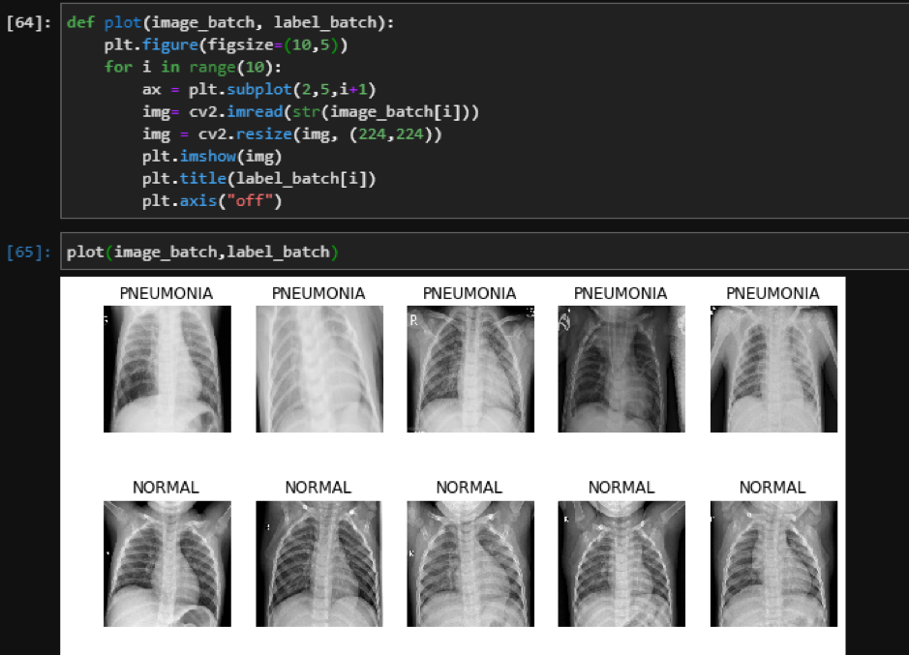
Image Classification / Recognition [Is it a [label, name]?]
Image Recognition - Classifying images into predefined categories. - CNNs excel at recognizing patterns and features in images. - Widely used in applications like photo tagging and medical imaging.
Image: projectpro.io

Slide 12
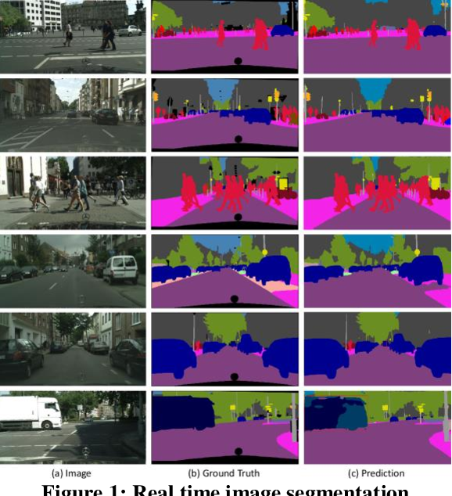
A pixel level classification: semantic segmentation
Image: semanticscholars

Slide 13

Object Detection (Presence: Is there an [object name]in the image / landscape/ supermarket aisle?
- Identifying and locating objects within an image. - Uses CNNs to classify and localize objects simultaneously. - Applications include self-driving cars, facial recognition, etc
Image:ywseo

Slide 14
Key Takeaways
- CNNs are powerful tools for image processing tasks. - They leverage convolutions, filters, and pooling layers for feature extraction and classification. - Essential for modern applications in computer vision

